Slide 1
Micro-Credit Loan Use Case
Presented by: Prashant Kumar

Slide 2
Introduction
A Microfinance Institution (MFI) is an organization that offers financial services to low income populations. MFS becomes very useful when targeting especially the unbanked poor families living in remote areas with not much sources of income. The Microfinance services (MFS) provided by MFI are Group Loans, Agricultural Loans, Individual Business Loans and so on.
Many microfinance institutions (MFI), experts and donors are supporting the idea of using mobile financial services (MFS) which they feel are more convenient and efficient, and cost saving, than the traditional high-touch model used since long for the purpose of delivering microfinance services. Though, the MFI industry is primarily focusing on low income families and are very useful in such areas, the implementation of MFS has been uneven with both significant challenges and successes.
We are working with one such client that is in Telecom Industry. They are a fixed wireless telecommunications network provider. They have launched various products and have developed its business and organization based on the budget operator model, offering better products at Lower Prices to all value conscious customers through a strategy of disruptive innovation that focuses on the subscriber.
They are collaborating with an MFI to provide micro-credit on mobile balances to be paid back in 5 days. The Consumer is believed to be defaulter if he deviates from the path of paying back the loaned amount within the time duration of 5 days. For the loan amount of 5 (in Indonesian Rupiah), payback amount should be 6 (in Indonesian Rupiah), while, for the loan amount of 10 (in Indonesian Rupiah), the payback amount should be 12 (in Indonesian Rupiah).
The sample data is provided to us from our client database. It is hereby given to you for this exercise. In order to improve the selection of customers for the credit, the client wants some predictions that could help them in further investment and improvement in selection of customers.

Slide 3
Problem Statement:
Build a model which can be used to predict in terms of a probability for each loan transaction, whether the customer will be paying back the loaned amount within 5 days of insurance of loan. In this case, Label ‘1’ indicates that the loan has been paid i.e. Non- defaulter, while, Label ‘0’ indicates that the loan has not been paid i.e. defaulter.

Slide 4
Hardware and Software Requirement and Tools Used:
Python(jupyter notebook)
Pandas
Numpy
Matplotlib
Seaborn
Sklearn
Classification models
Grid search
Evaluation metrics
Ensembling

Slide 5
Mathematical/ Analytical Modelling of the Problem
As we have seen in problem statement that it’s a classification problem where we have to identify whether the customer will be paying back the loaned amount within 5 days of insurance of loan or not.
So we will use 4 important classification algorithms to solve this problem and
Will finalize any one which prediction is best among all.
Algorithms we will use are :
Testing of Identified Approaches (Algorithms)
LogisticRegression
RandomForestClassifier
AdaBoostClassifier
XGBClassifier

Slide 6
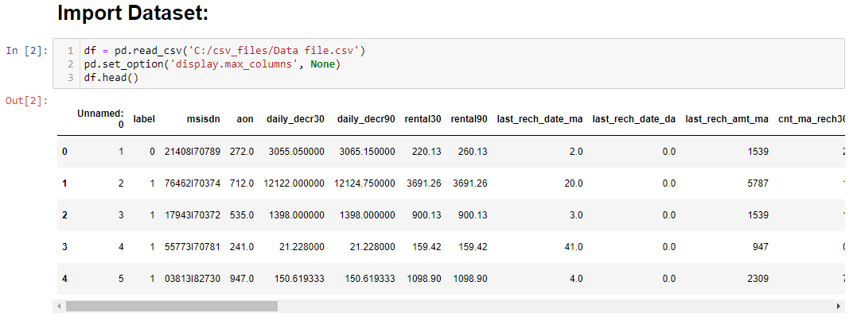
Data Sources and their formats:
The Microfinance services (MFS) provided by MFI are Group Loans, Agricultural Loans, Individual Business Loans and so on. The sample data is provided to us from our client database. It is hereby given to you for this exercise. In order to improve the selection of customers for the credit, the client wants some predictions that could help them in further investment and improvement in selection of customers. Dataset contain 209593 observations and 37 features. Label contain Flag indicating whether the user paid back the credit amount within 5 days of issuing the loan{1:success, 0:failure}. It was provided in as csv file.

Slide 7
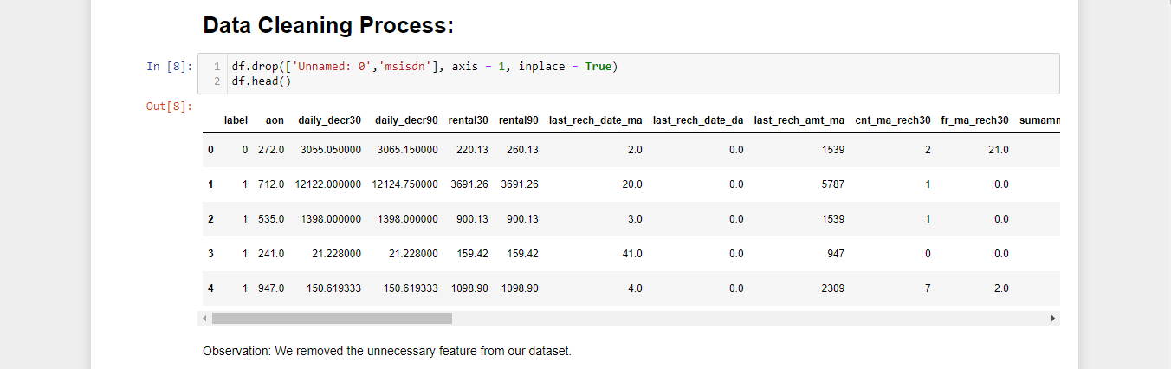
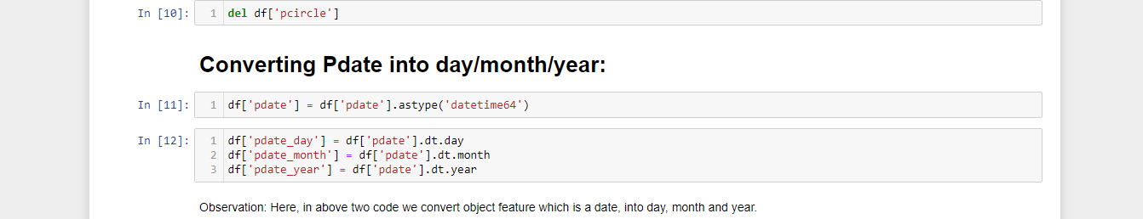
Data Pre-processing:
Feature ['Unnamed: 0'] having id & ['msisdn'] have mobile number so both unique identity features so we can simply remove it.
Dataset have no null values
Feature pdate contains date as model cant process data as its so i have extracted day/month/year in separate columns.

Slide 8
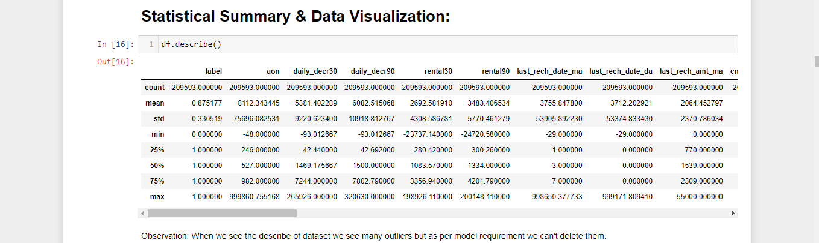
Data Describe:
Observation:
In feat. 'aon' min value showing in negative & max showing 999860 both value are outliers.
in feat. 'daily_decr30' min value in negatibe & max showing 265926 both values seems outliers.
in feat. 'daily_decr90' min value in negatibe & max showing 320630. both values seems outliers.
rental30 negative values are outliets.
rental90 negative values are outliets.
last_rech_date_ma negative values are outliers.
last_rech_date_da negative values are outliers.
medianmarechprebal30 negative values are outliers.
medianmarechprebal90 negative values are outliers.
cnt_loans90 max value is also outliers.
few others are having min value as 0 that also seems outliers.

Slide 9
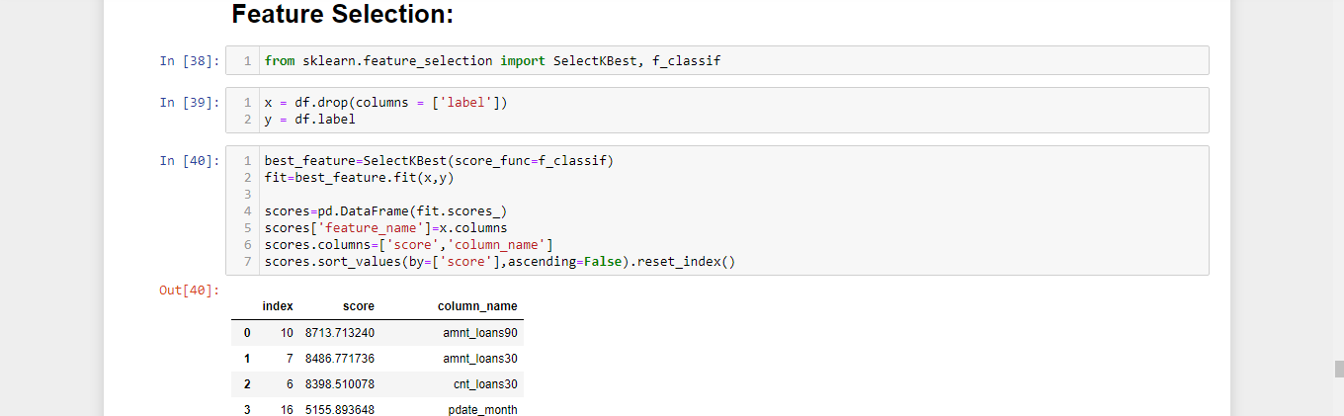
Feature Selection:
As we have many features in dataset and some features have very less or no relation with target label. so we will apply feature selection to select best features. I will use sklearn tool SelectKBest and function-f_classif.

Slide 10
Heatmap
Heat map draw for correlation and multicollinearity.
daily_decr30 have multicollinearity with daily_decr90 and rental30 have with rental90. so we can remove one from each pair.
few feature have very or no correlation with label so we can remove these features.
fr_da_rech90 -0.007200
medianmarechprebal30 -0.004101
aon -0.003016
fr_da_rech30 -0.000827
maxamnt_loans30 0.000461
fr_ma_rech30 0.000559
cnt_da_rech90 0.000783
last_rech_date_da 0.000900
last_rech_date_ma 0.003305
cnt_da_rech30 0.004313
cnt_loans90 0.004460

Slide 11
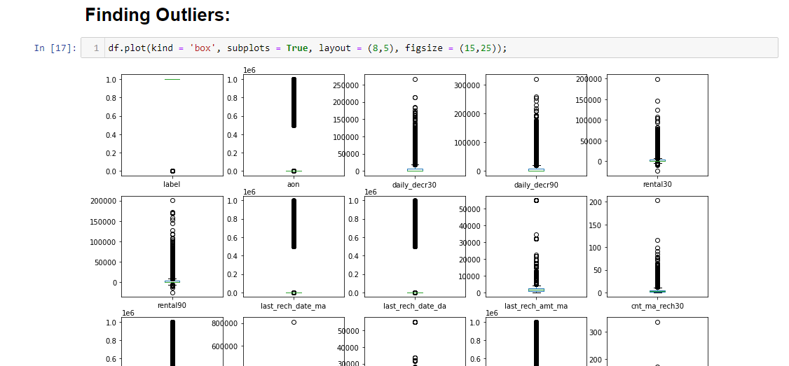
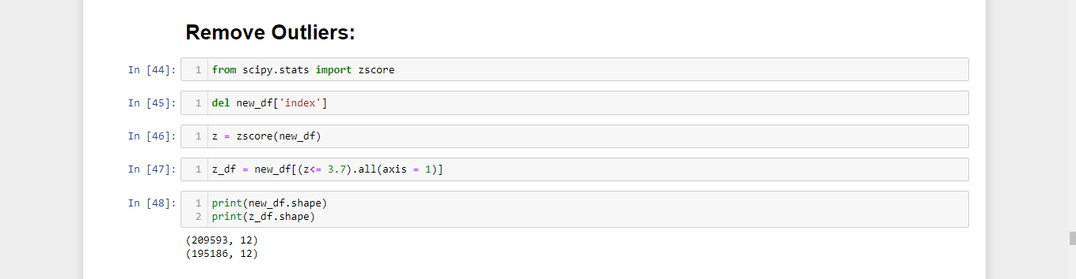
Outliers & Removal of Outliers:

Slide 12
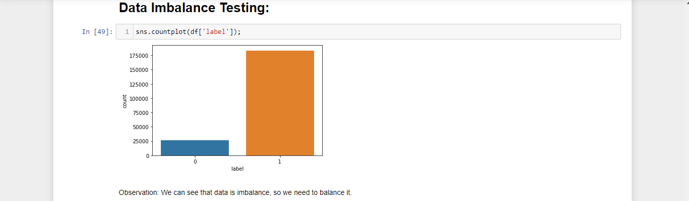
Data Imbalancing:
The dataset is imbalanced. Label ‘1’ has approximately 87.5% records, while, label ‘0’ has approximately 12.5% records. if the data set in imbalance then In such cases, you get a pretty high accuracy just by predicting the majority class, but you fail to capture the minority class, which is most often the point of creating the model in the first place.
So to balance both the classes I will implement resampling

Slide 13
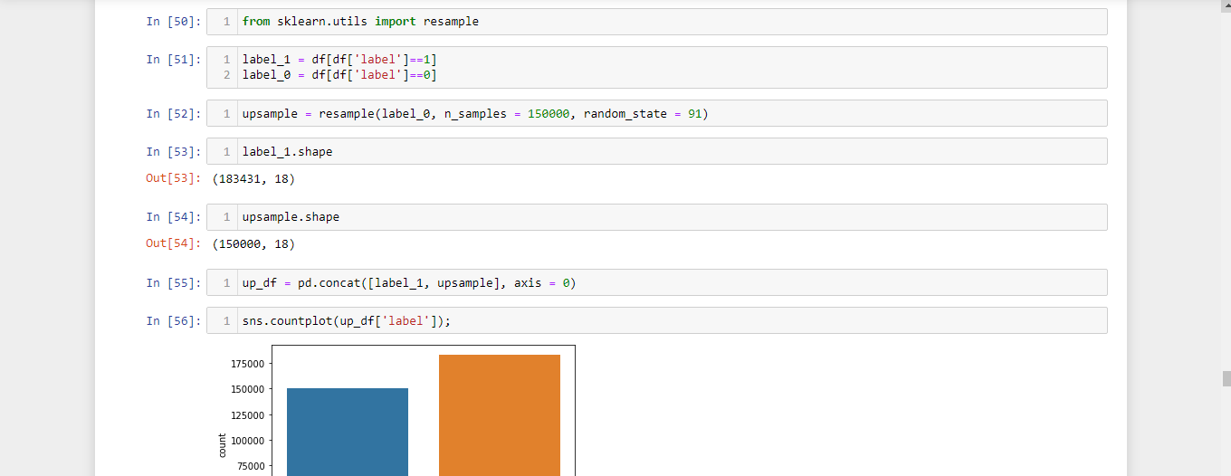

Slide 14
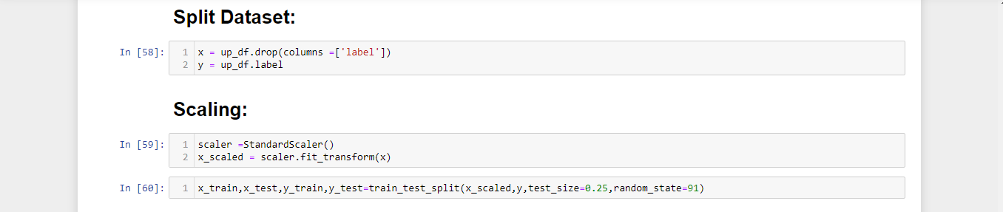
Preprocessing-Scaling/Spliting/Training_Test_Split:
Scaling-Scaling is very important part in machine learning as we have different features which have values in different scale. So can be biased for some particular features. So its good idea to convert all features in same scaling. We will use standard scaler here.
Splitting-As our dataset is ready now to building model but before that we will split data X-as features and y-as classification label.
Train_test_split-Its last but most important part before apply ML algorithms.
It will split our data set as training data-in which model will be train, Testing data-in which model to be evaluate.

Slide 15
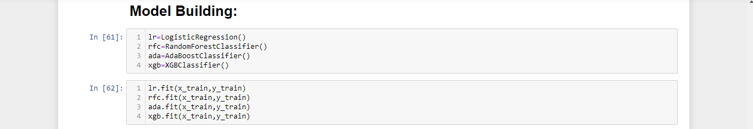
Run and Evaluate selected models:
Testing of Identified Approaches (Algorithms)
LogisticRegression
RandomForestClassifier
AdaBoostClassifier
XGBClassifier
As its classification model so will try to 4 algorithms here, out of all 3 algorithms are ensemble algorithms.

Slide 16
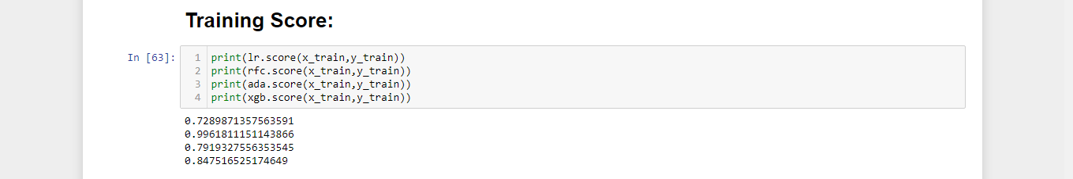
Run and Evaluate selected models:
In previous slide we have seen that we applied 4 algorithms and trained all. Here we will check training score of each algorithm and then we will give test data to all models. After that we will check score of individual algorithm.
Here its clearly shown that Random forest training score is maximum and its around 100%.

